Slide 1
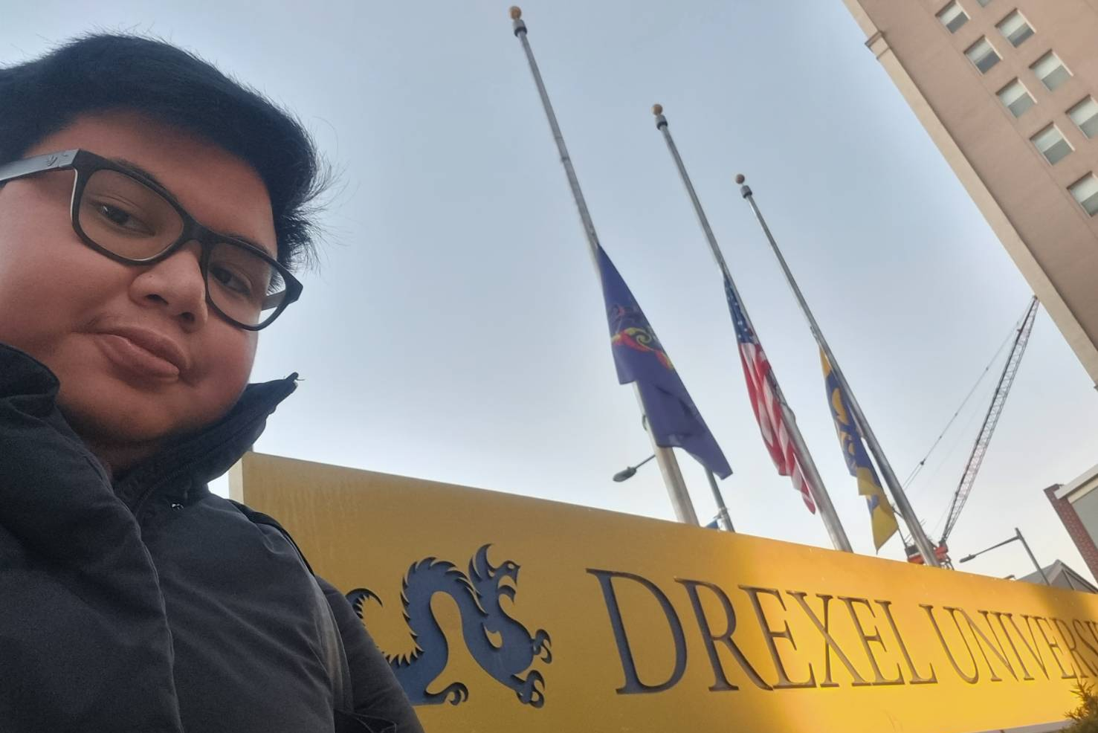

Study Abroad at Drexel University, Philadelphia
Joshua Theodore Setyawan TK20

Slide 2
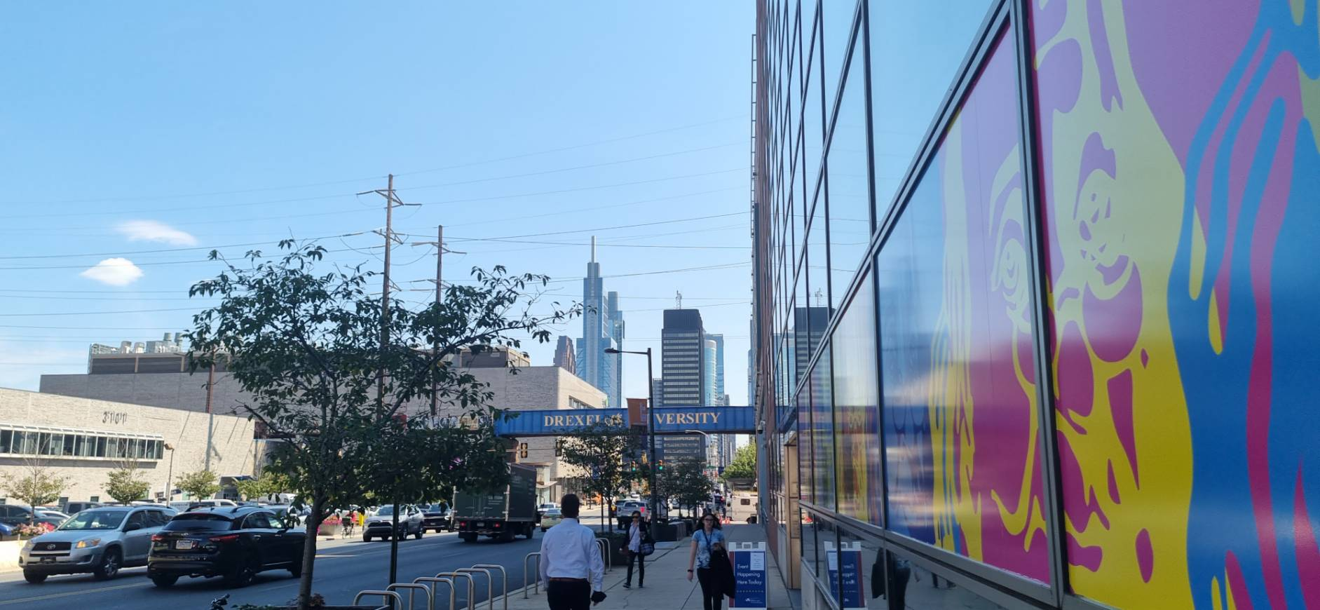

Drexel University
Located in Philadelphia, Pennsylvania, US
Situated close to the city in an area called University City

Slide 3
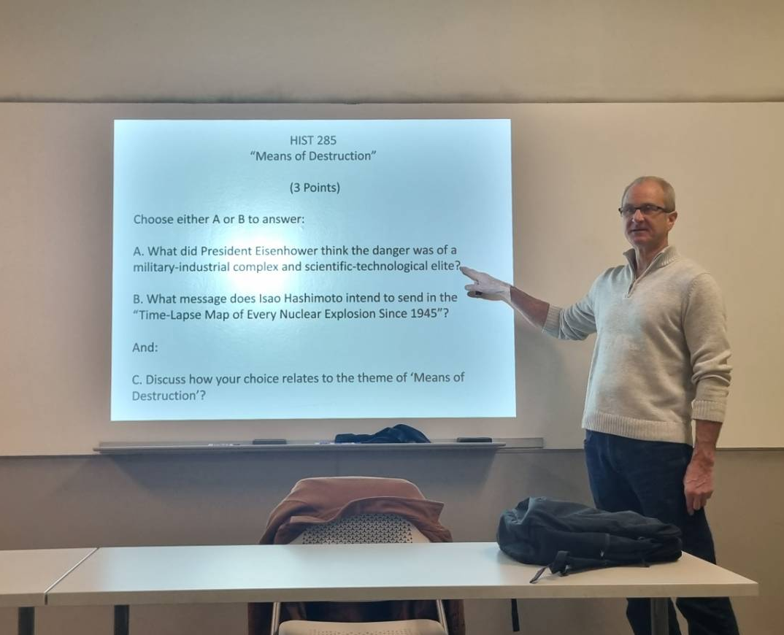
Academic Life
Engaging lecturers
Reading assignments
Attendance did not affect grade

Slide 4
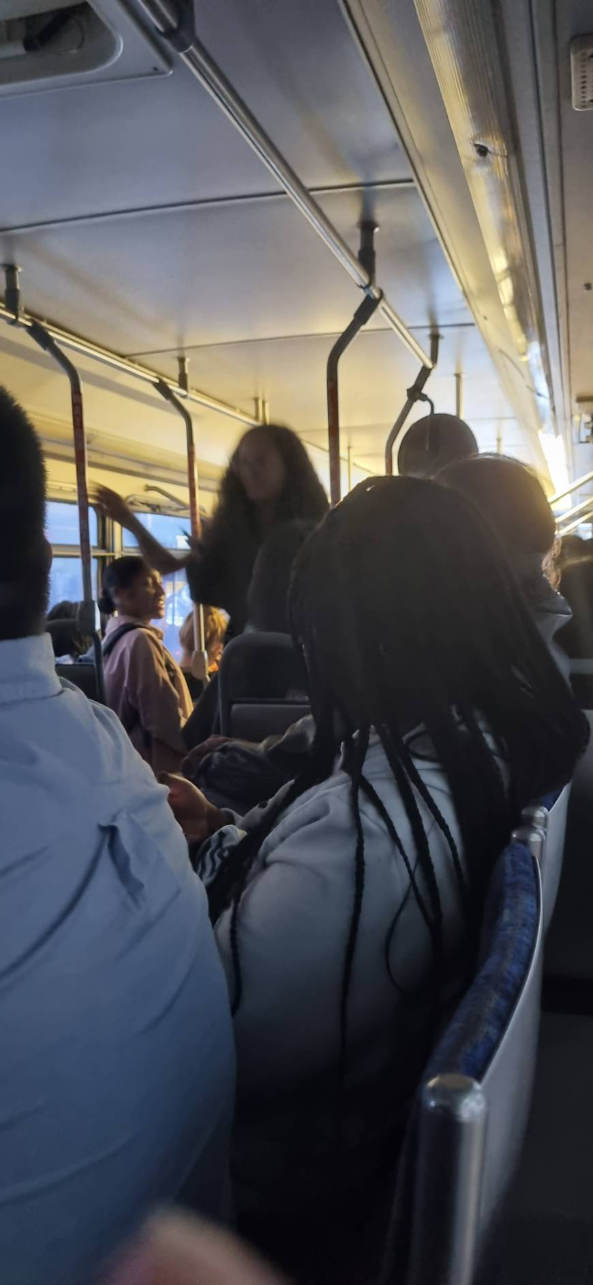
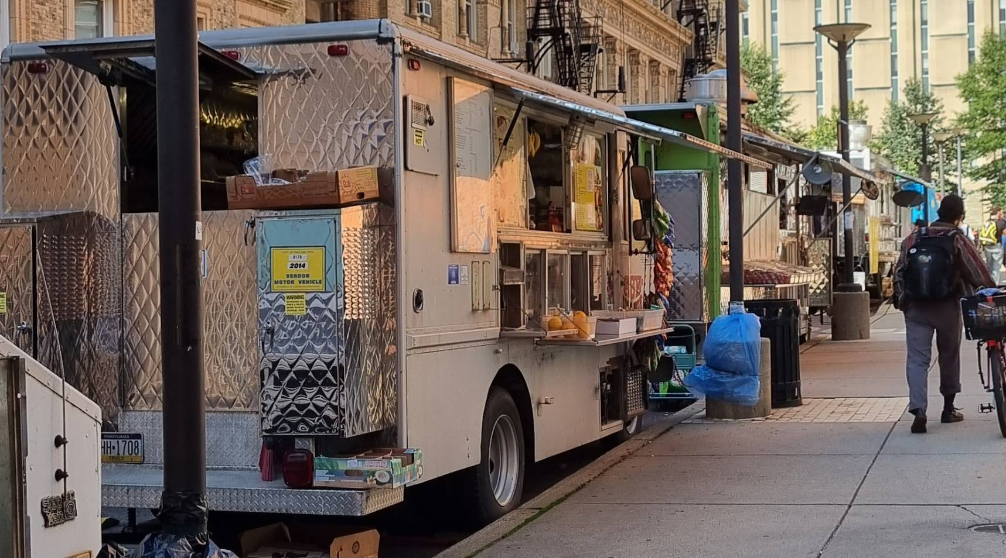
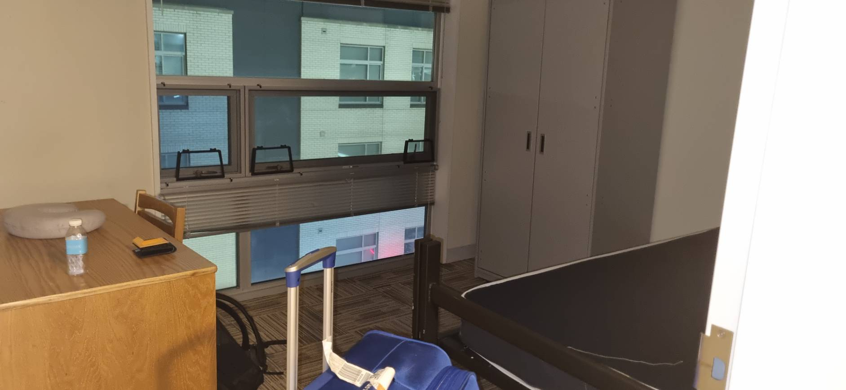
Daily Life

Slide 5
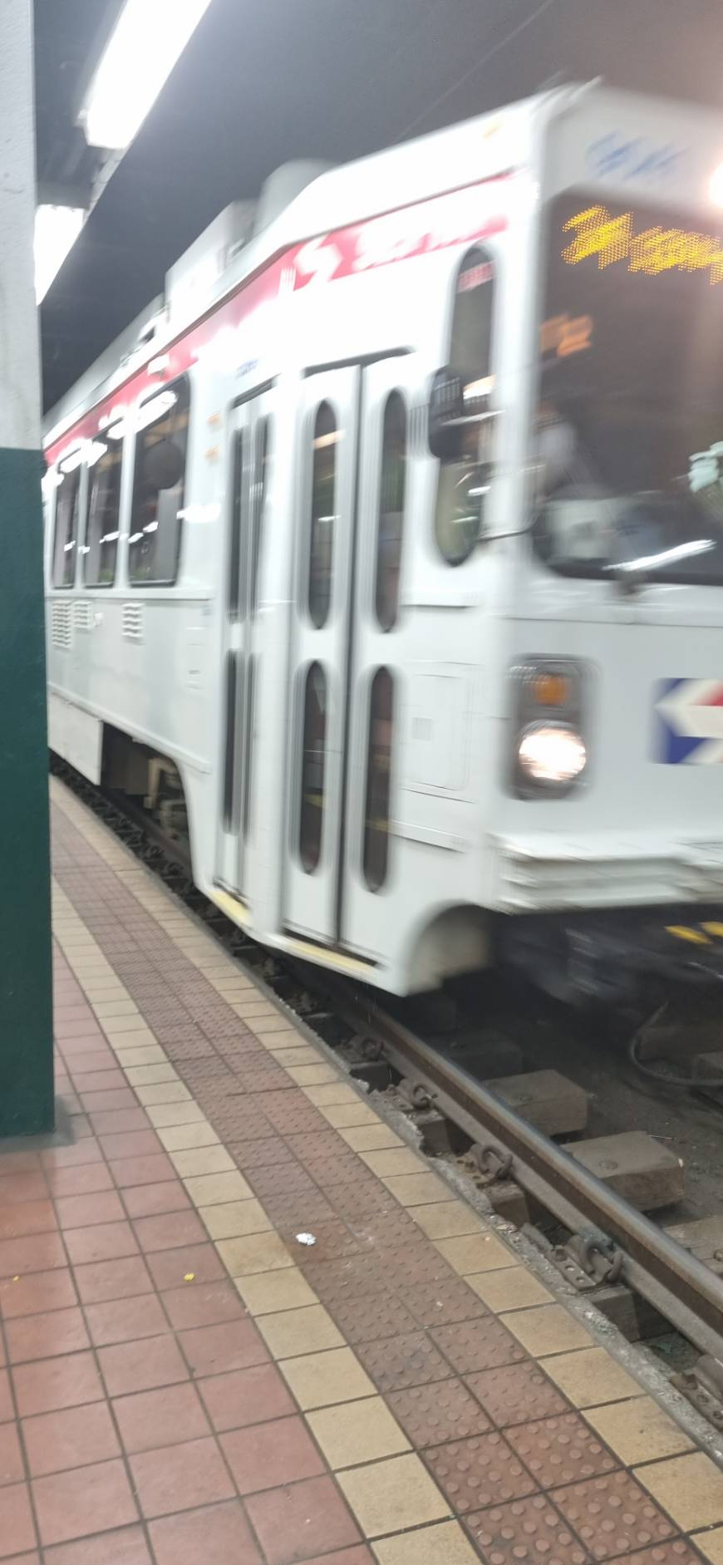
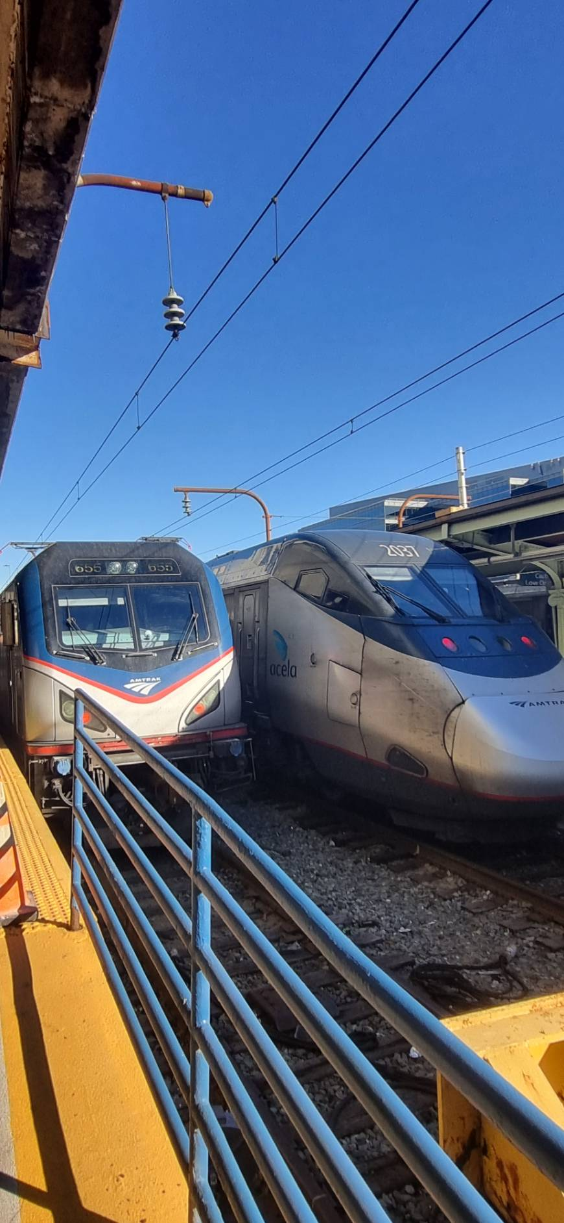
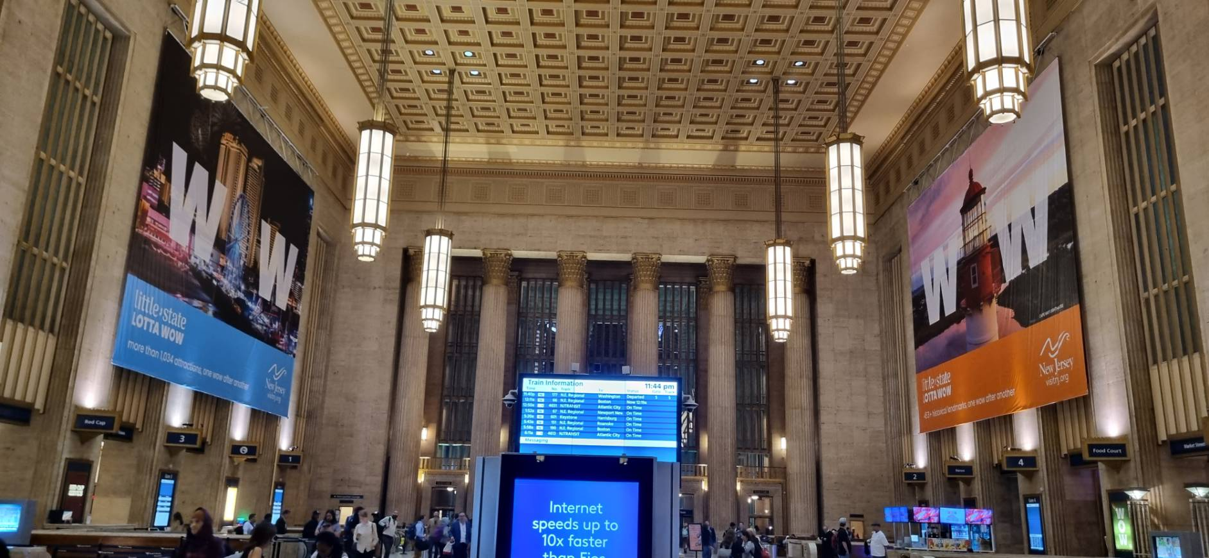
Public Transportation

Slide 6
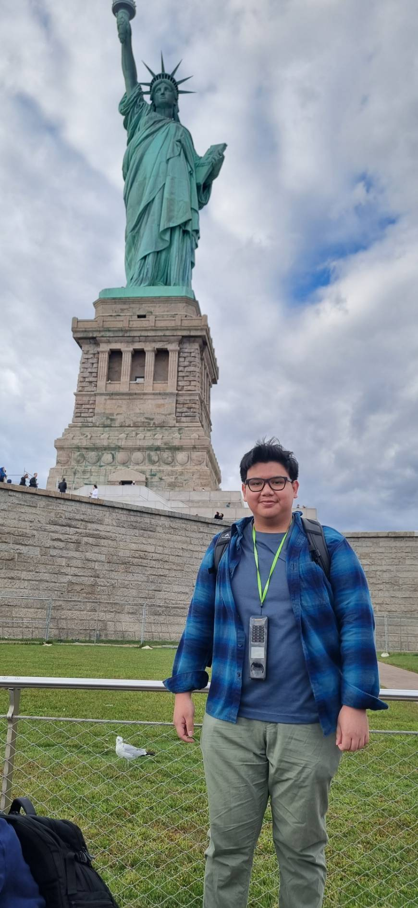
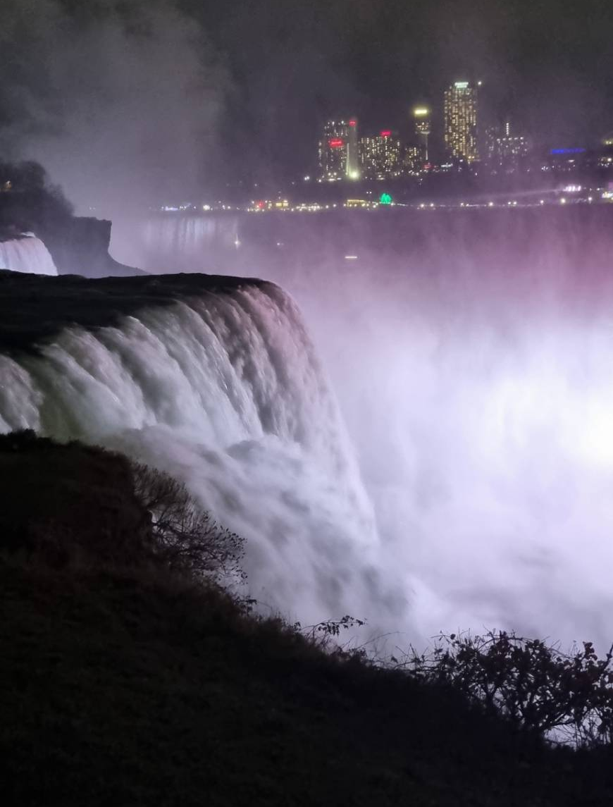
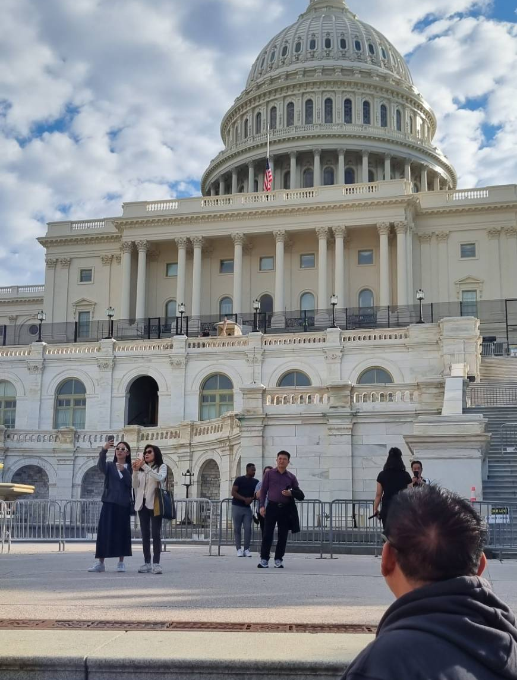
Holiday around Northeastern U.S.

Slide 7
Safety in U.S. Cities
Avoid bad Neighborhoods
Campus area is very safe
Public Transport is relatively safe especially in New York and DC
Follow advice from friends and lecturers
Always aware of the situation (News, campus announcement)

Slide 8
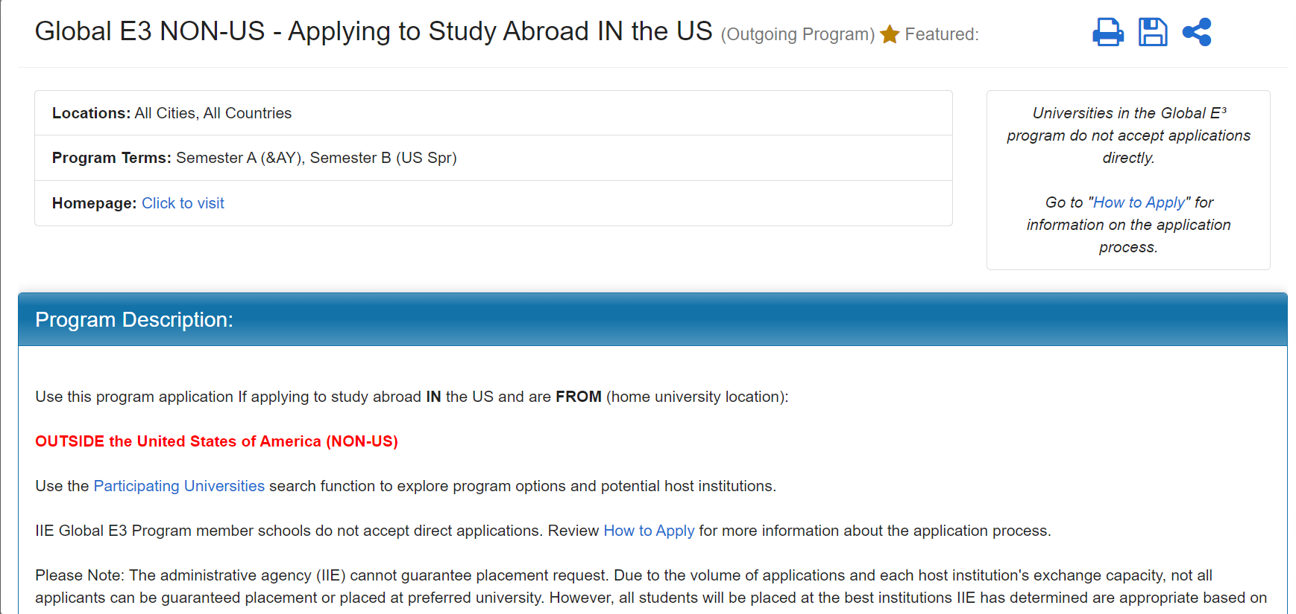
Global Engineering Education Exchange
globale3.studioabroad.com

Slide 9

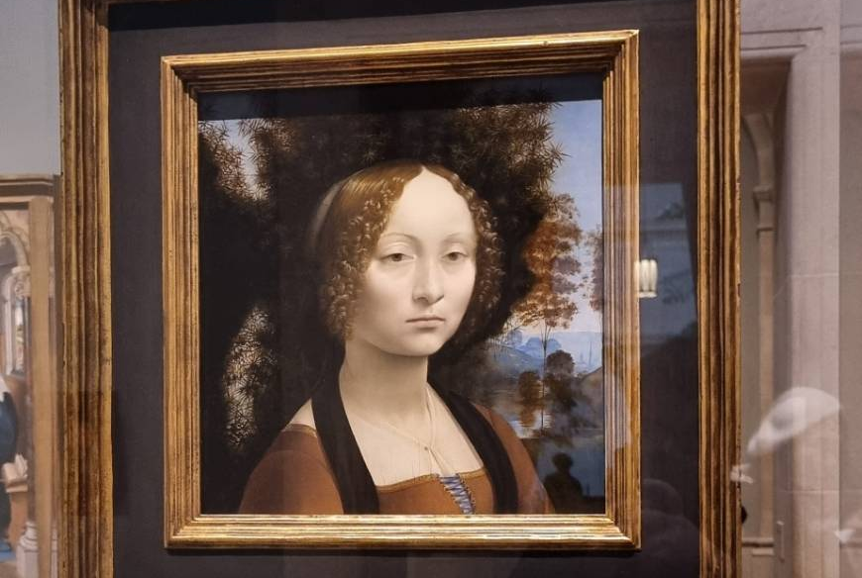
Thank You

